Slide 1


SAP UI5 & FIORI with OData TRAINING using BAS
Anubhav Oberoy
Day – 20

Slide 2

Agenda – Day 20
Building Get Entity set Method
Testing the Get Entity set Method in Browser
Building Get Entity method (Single Product)
Introduction to the Postman Tool
Setting the Authorization in Postman
Testing Get Entity and Entity set using Postman
Implementing Create in OData Service
Testing POST calls in the SAP Logon
Testing POST calls using postman
How to set payload in postman to test POST call
Introduction to x-csrf-token
Implementing Update and Delete in service
Adding Supplier Entity set
Introduction to Association
Associating Supplier Set to Product Set
Introduction to Function Import
Creating a Function to get Most expensive product
Basics of Connectivity
Introduction to Cloud Connector
Steps to Setup the Cloud Connection.
Creating the destination in the BTP for BAS
Creating the destination in the Vscode

Slide 3
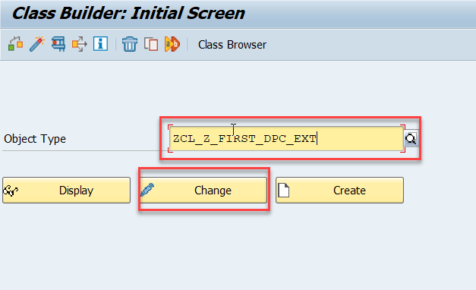
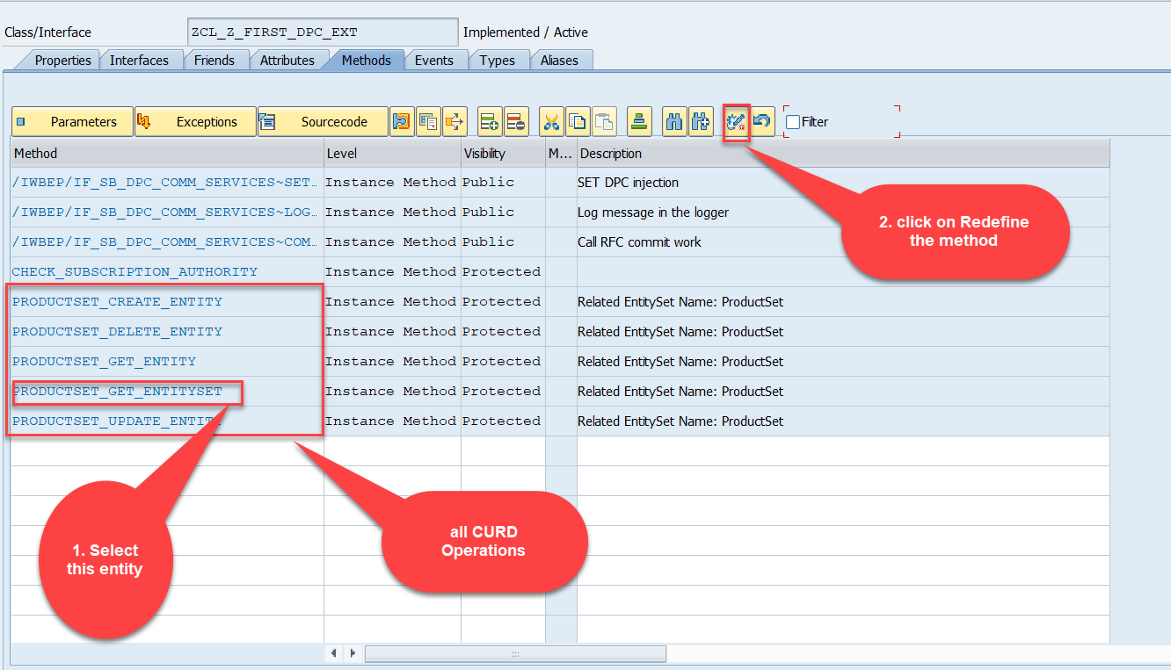
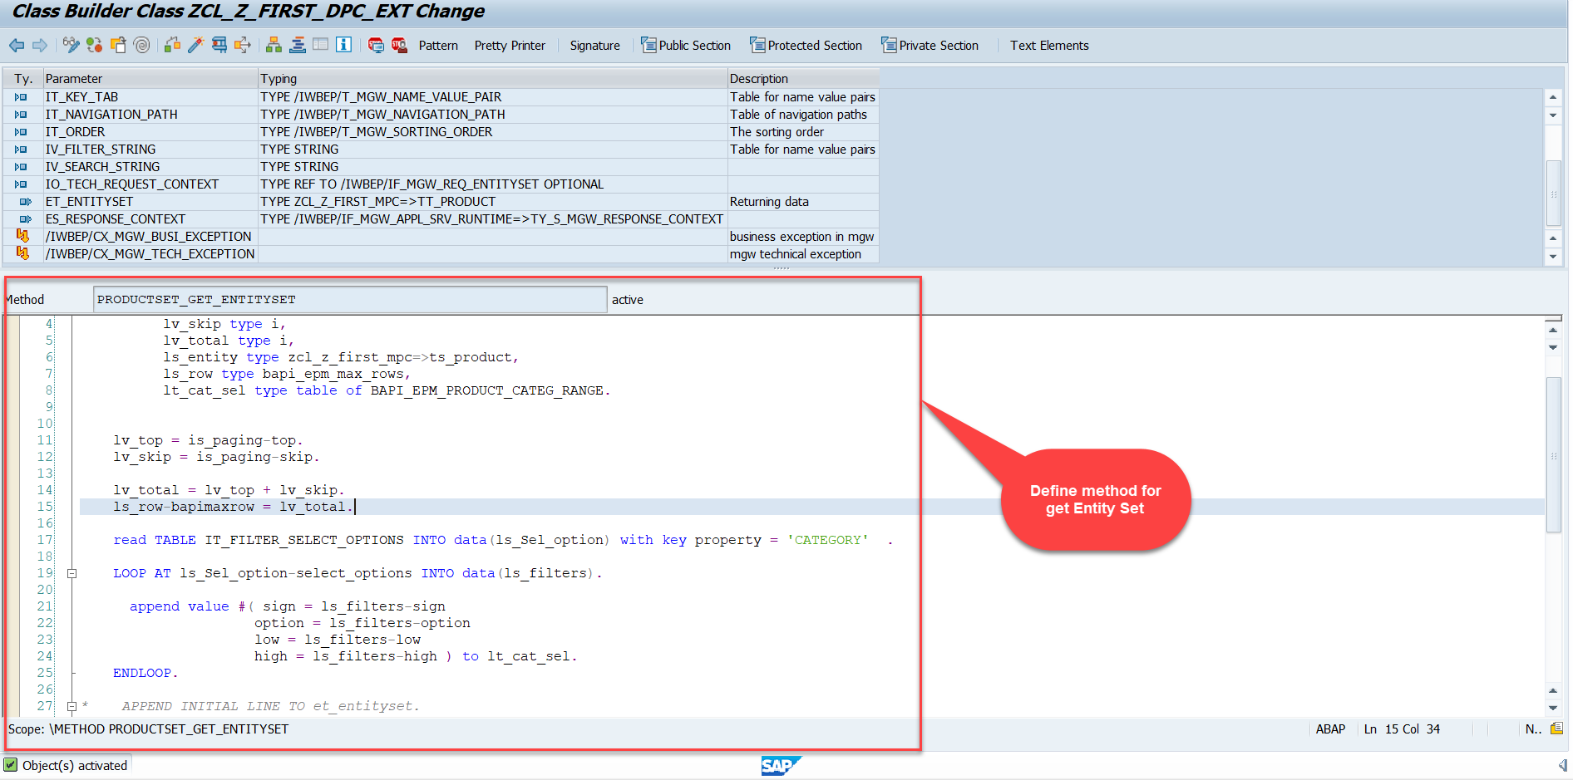
Building Get Entity Set Method for ProductSet
ProductSet Get EntitySet method(with filter, top and skip) in DPC Extension (Class Builder tcode- se24)
After adding the code just activate the service.
Code for PRODUCTSET_GET_ENTITYSET:
GetEntitySet

Slide 4
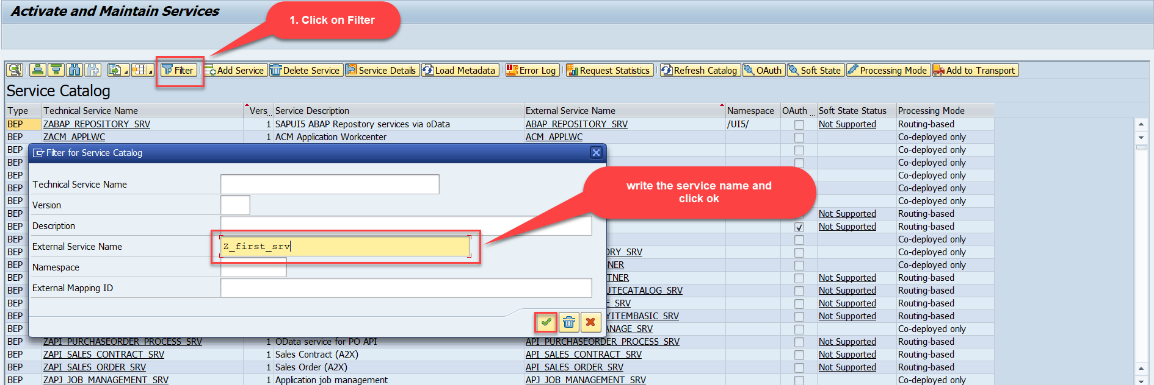
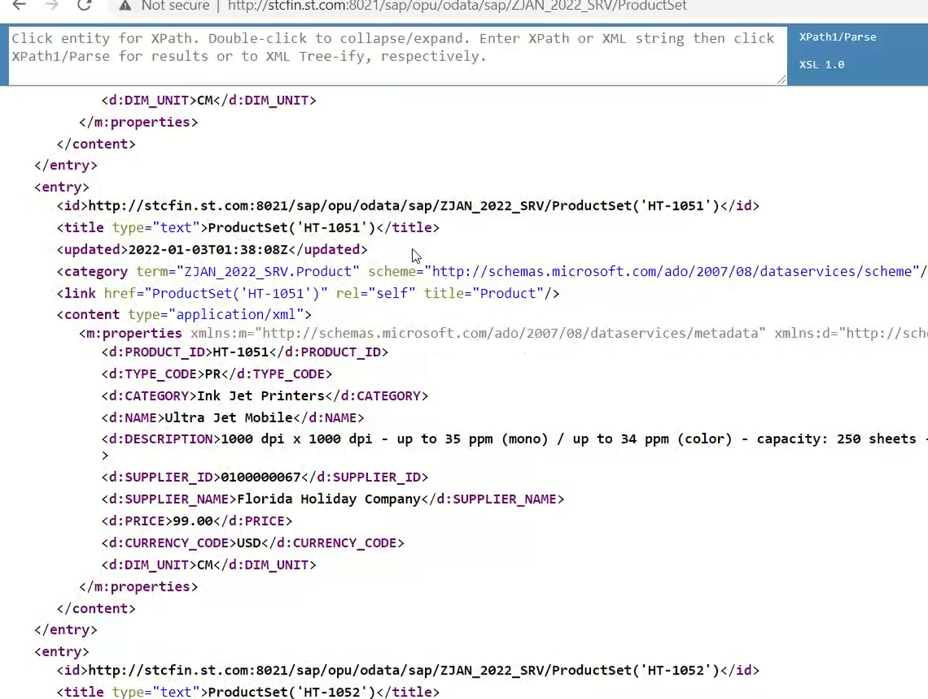
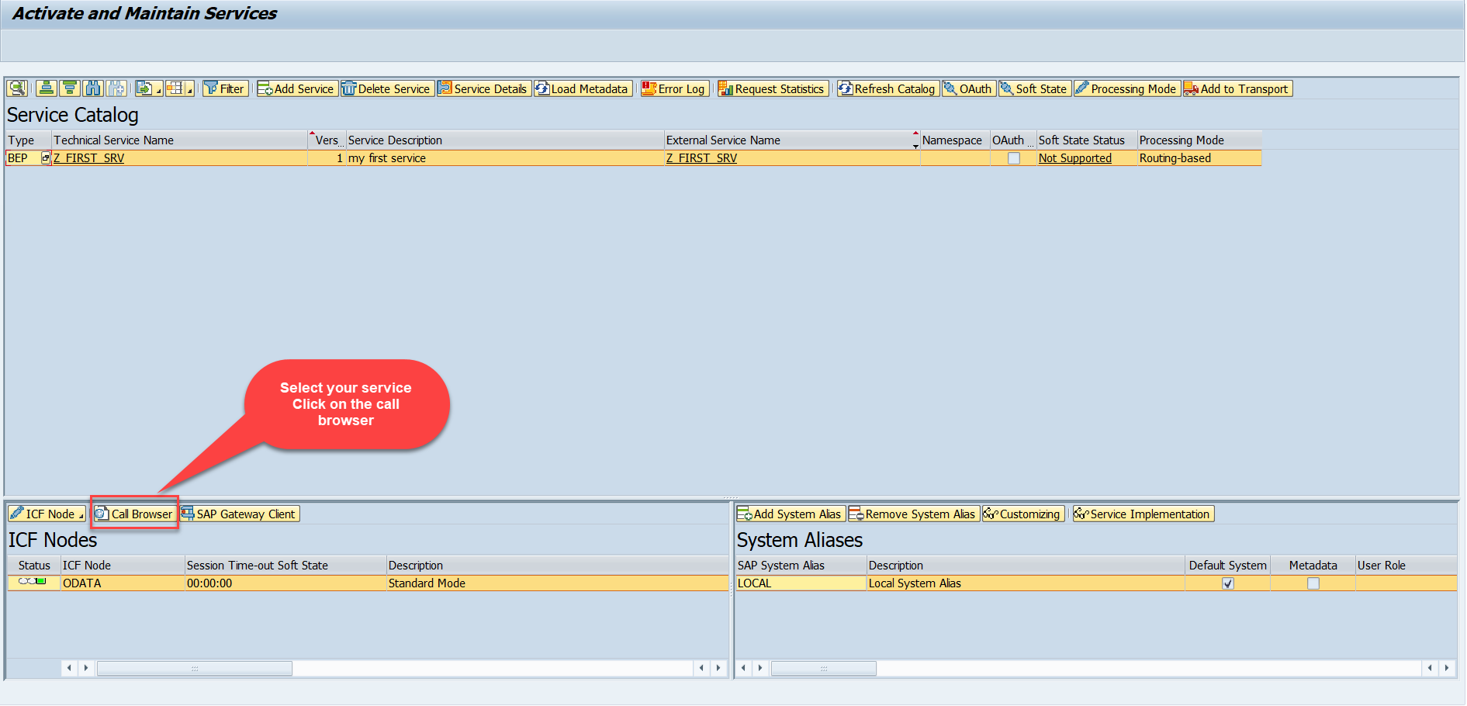
Test the Get Entity Set in Browser
Now enter the Tcode - /n/iwfnd/maint_service and, there search our service using the filter option.
Now select the service and press the Call Browser button to open it in the Browser window.
Just add /ProductSet at the end of the service to call the get product get entity set method
Calling the ProductSet in browser

Slide 5
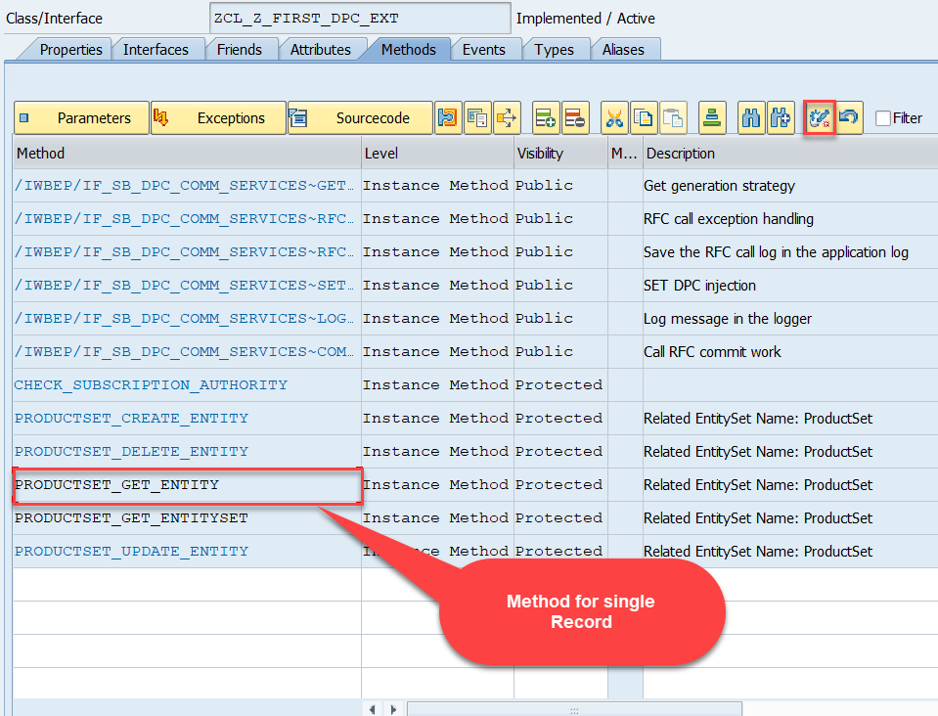
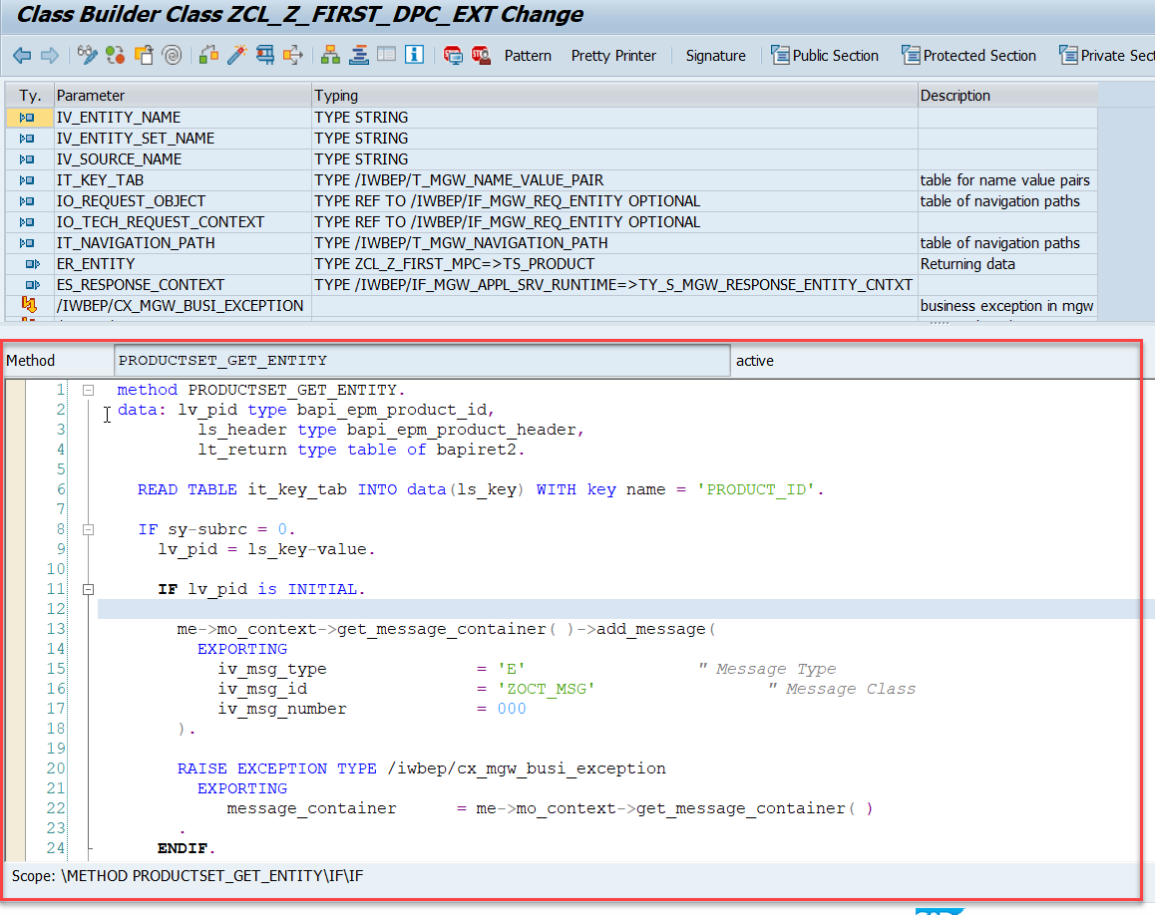
Building Get Entity Method
Go to DPC Extension class of our service and redefine the method PRODUCTSET_GET_ENTITY and put the below provided code.
Code for PRODUCTSET_GET_ENTITY:
GetEntity

Slide 6

Postman
Postman is a free tool which can be used to test any kind of REST/OData Services outside of the system. This allows us to consume the data as if an external consumer would really do.
Postman is an API platform for building and using APIs. Postman simplifies each step of the API lifecycle and streamlines collaboration so you can create better APIs—faster.
As an ABAP developer, you can develop postman collection and deliver it to Fiori Developers for consumption to showcase, what our service is capable of.
Postman can run GET, POST, PUT, PATCH, MERGE, DELETE, and various other request methods as well, and has utilities to help with developing APIs. Free and paid versions are available for Mac, Windows, Linux, and as a Chrome app.
You can Download the postman tool from the link give below: https://www.postman.com/downloads/

Slide 7
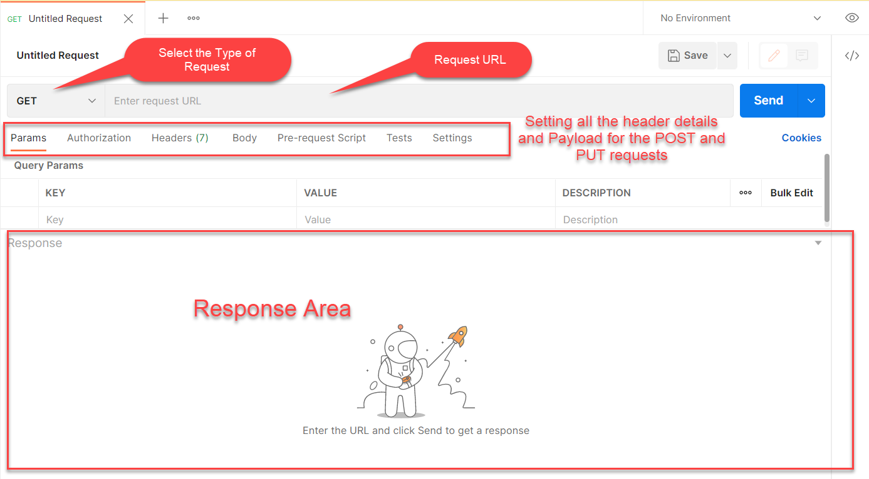
Postman App Layout
The below screen shot shows a basic layout of a request in Postman

Slide 8
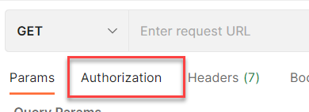
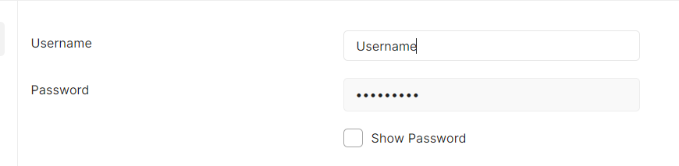
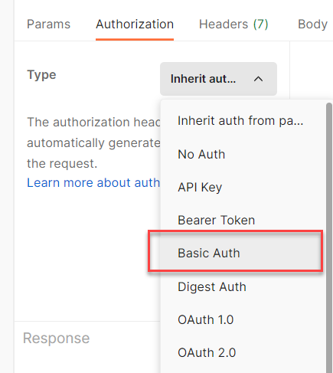
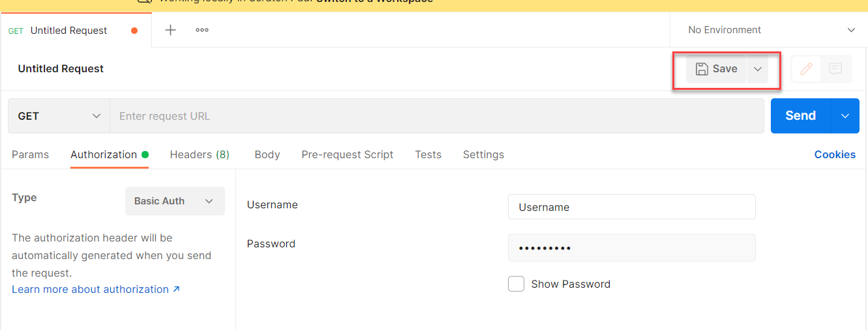
Setting Basic Auth in Postman
Step 1: Go to the Authorization section.
Step 3: Set the Username and Password.
Step 2: Select Basic Auth as Type
Step 4: Save.

Slide 9
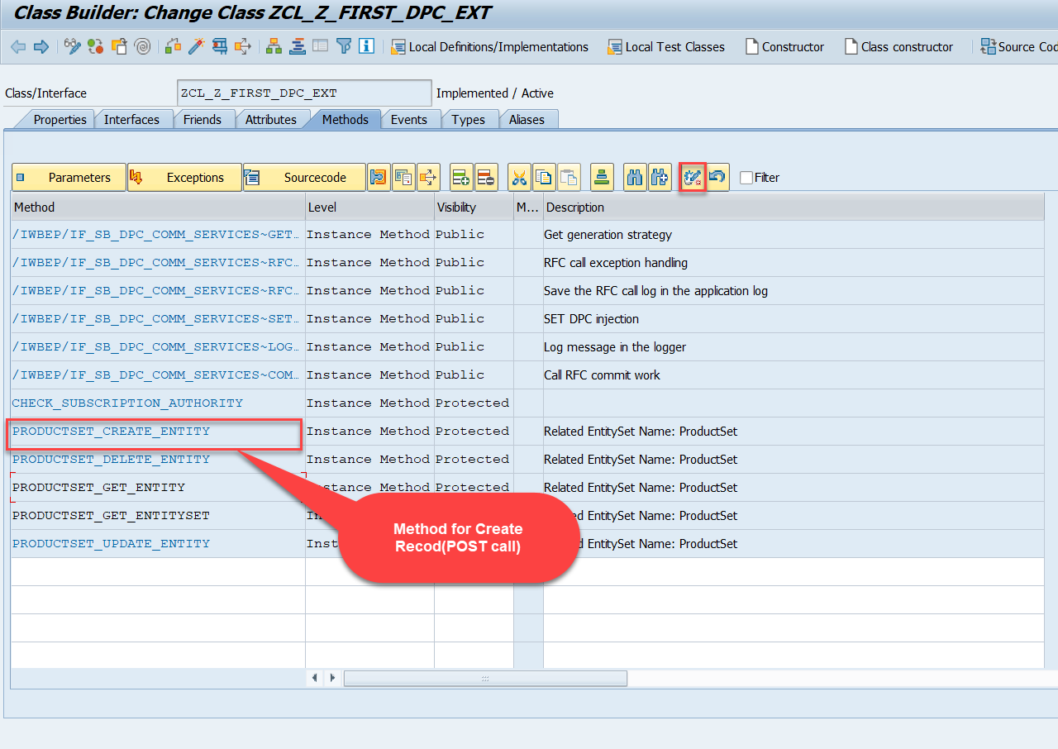
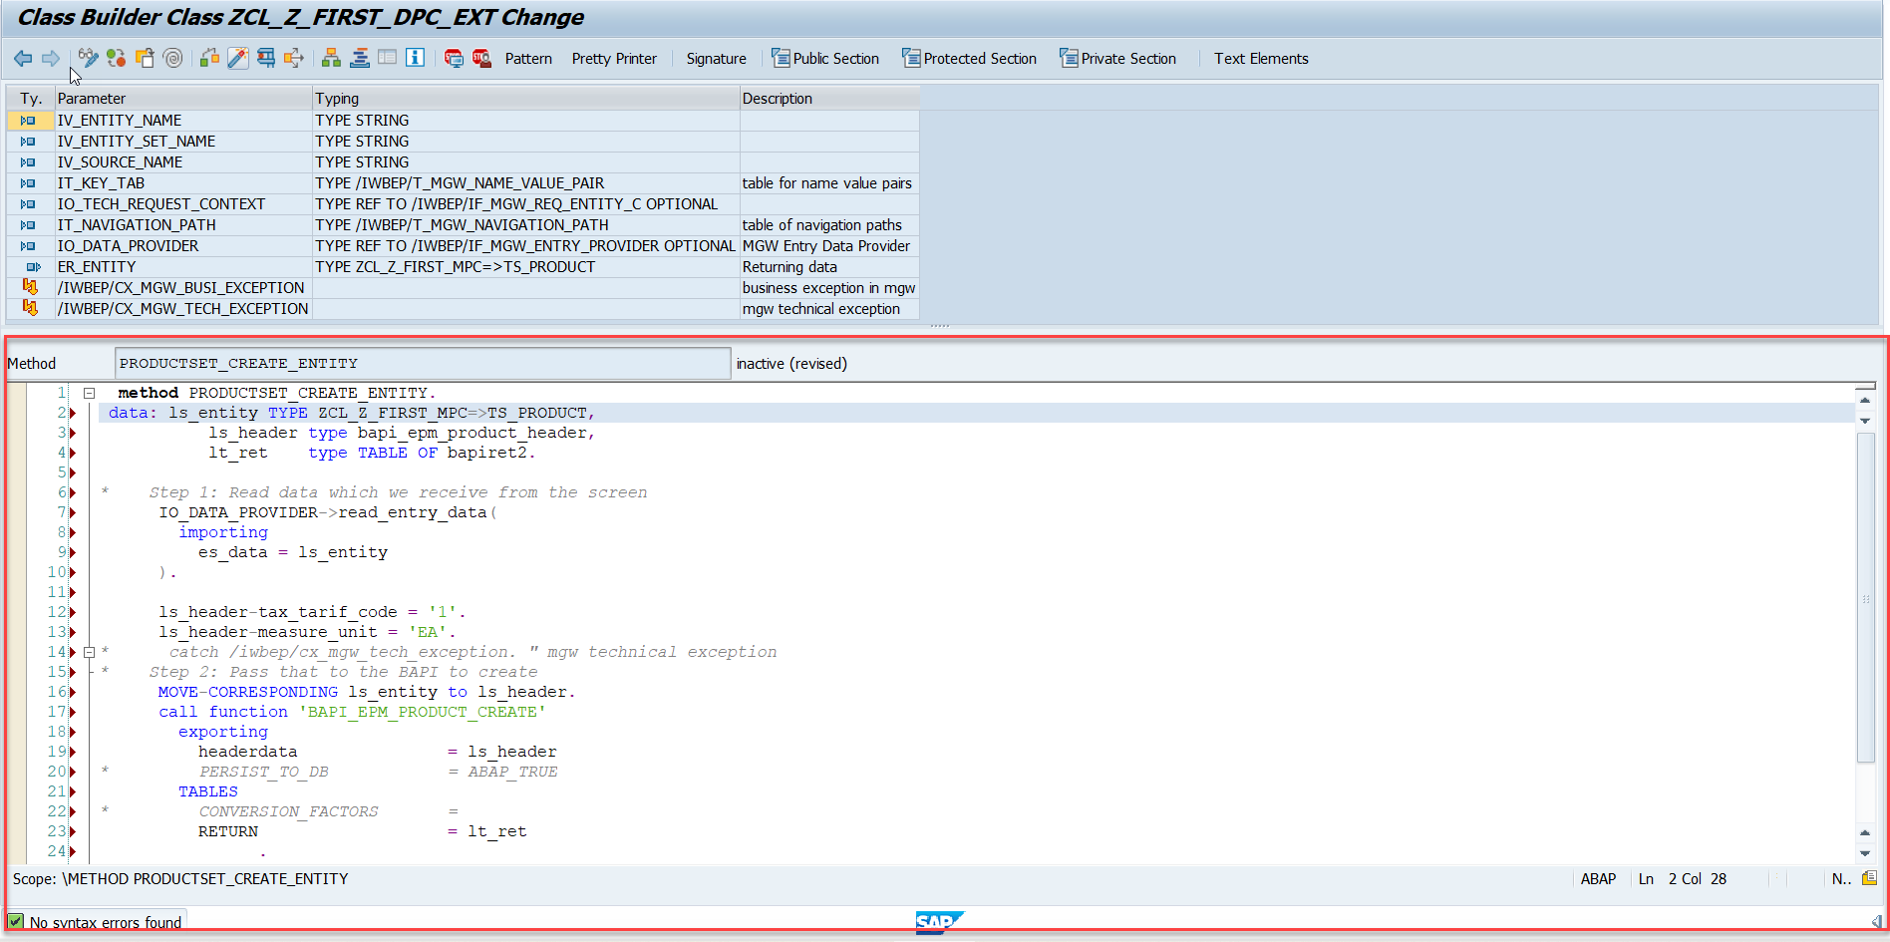
Building CreateEntity(POST) Method
To implement the Create operation in our odata service, go to DPC Extension class of over service and redefine the method PRODUCTSET_CREATE_ENTITY
Code for PRODUCTSET_CREATE_ENTITY: CreateProductEntity

Slide 10
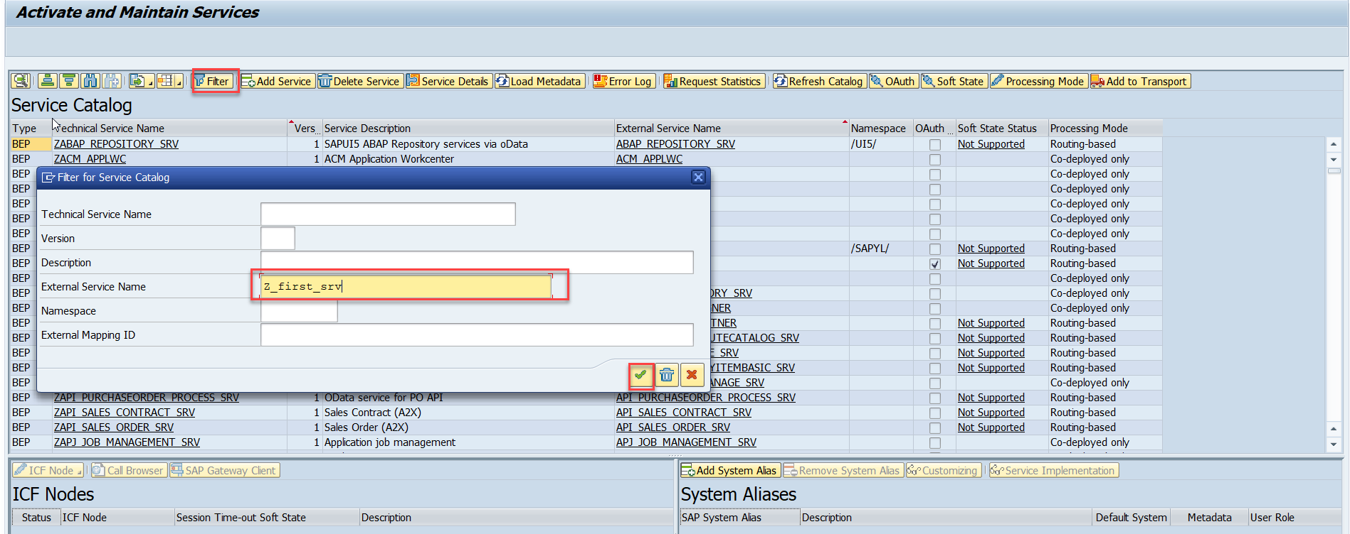
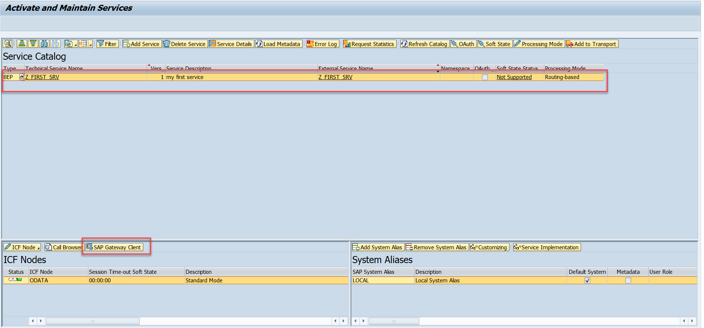
Testing Create Method at Sap Gateway client
Step:1 Go to sap service maintance(tcode- /iwfnd/maint_service) and search for the service and then select the service and click on the sap gateway client

Slide 11
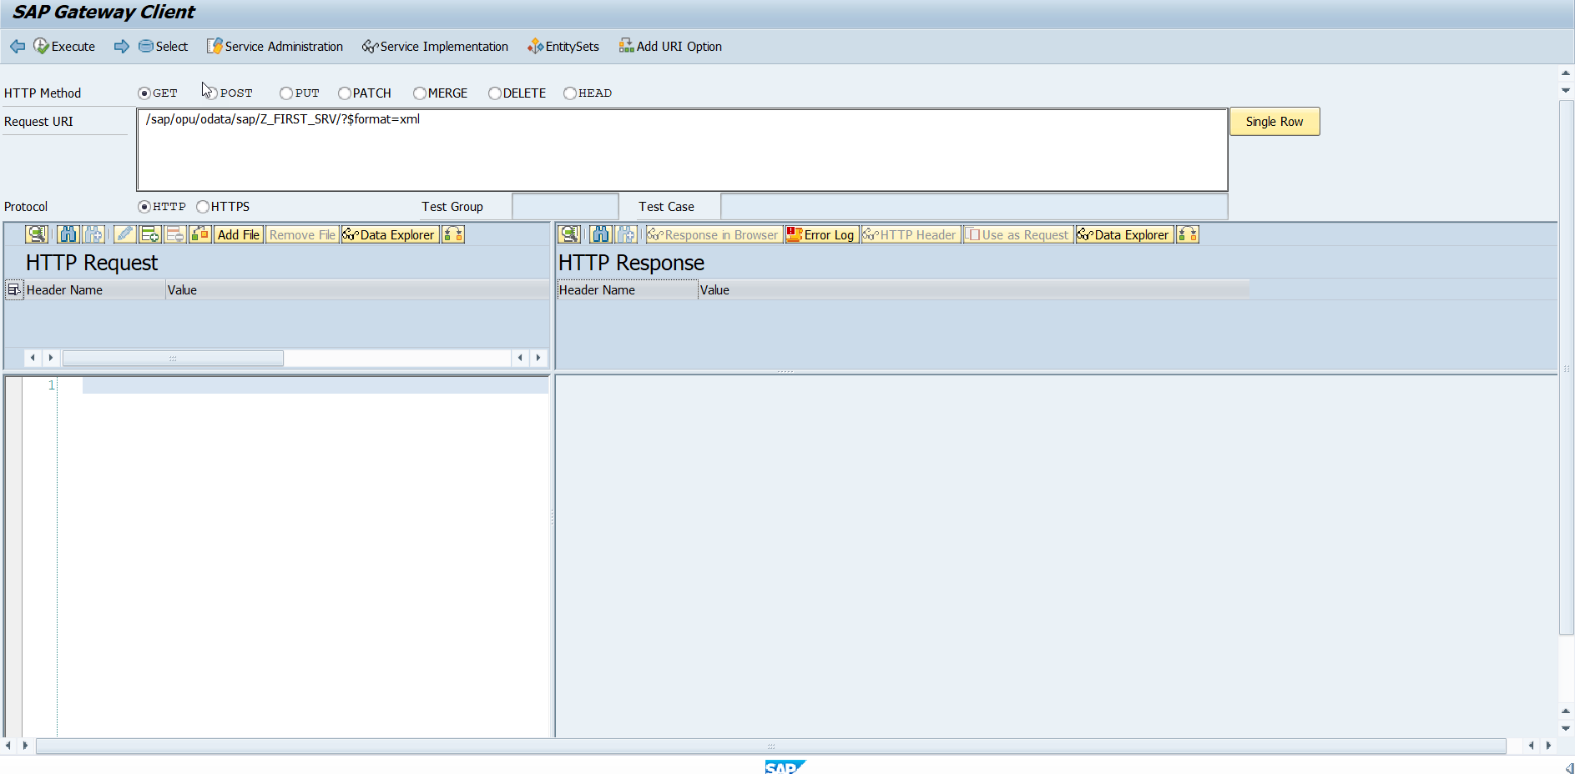
Testing Create Method Continue…
Step:2 Go to sap service maintance(tcode- /iwfnd/maint_service) and search for the service and then select the service and click on the sap gateway client

Slide 12
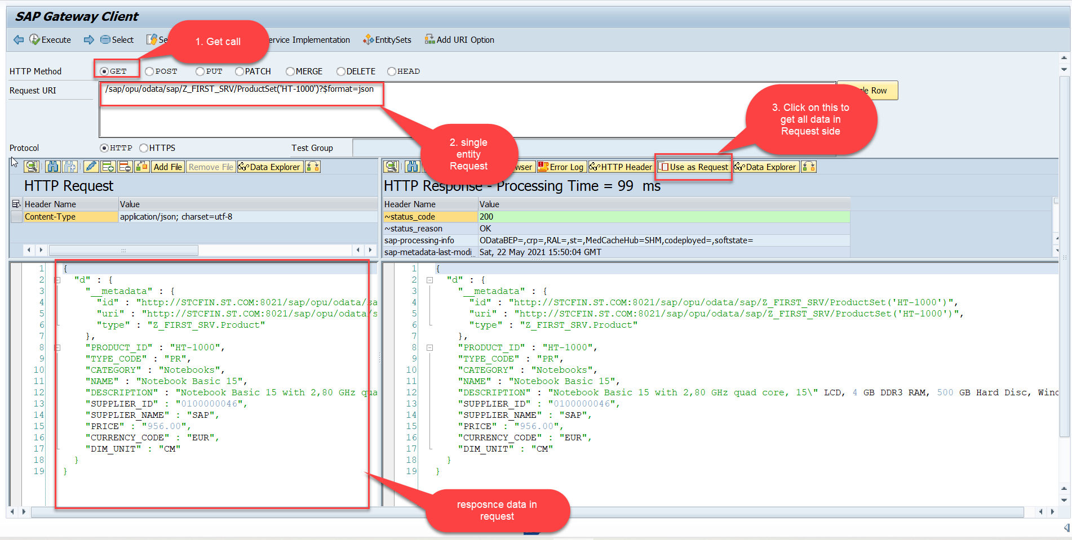
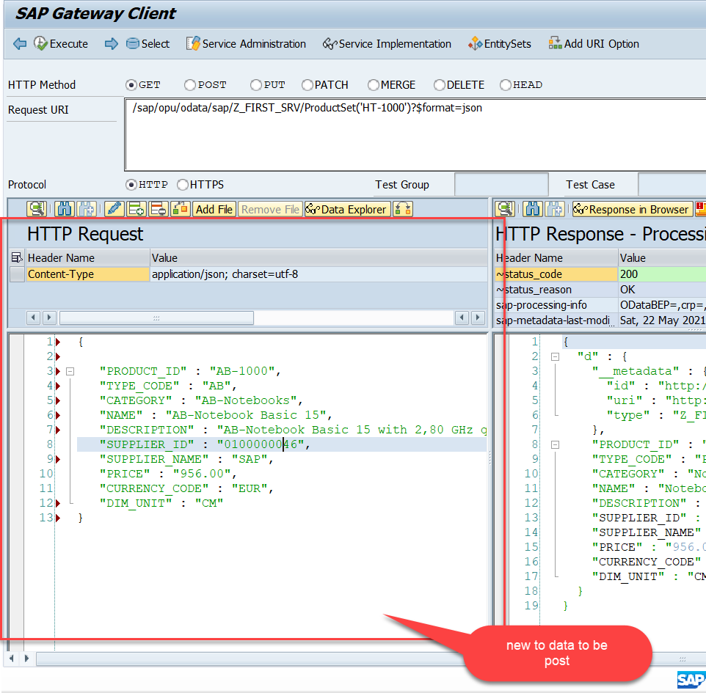
Testing Create Method Continue…
Step:3 Perform a getEntity in the Product set to get the payload to post (/sap/opu/odata/sap/Z_FIRST_SRV/ProductSet('HT-1000')?$format=json) and then clean the data and modify the payload as new.

Slide 13
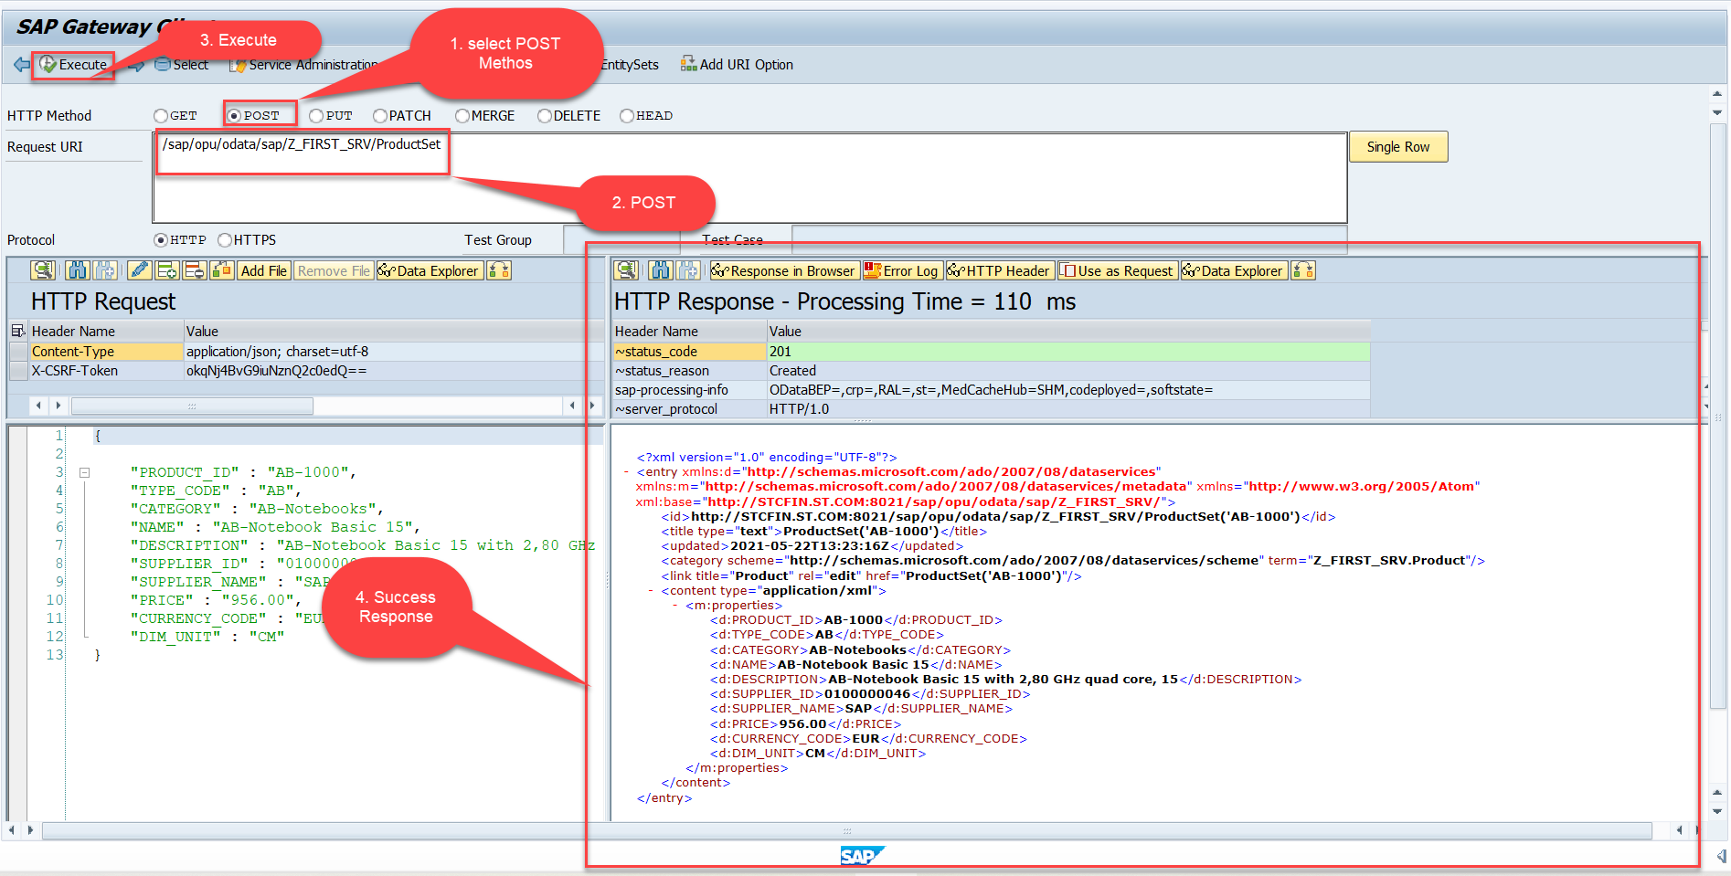
Testing Create Method Continue…
Step:4 send the post request at (/sap/opu/odata/sap/Z_FIRST_SRV/ProductSet)

Slide 14
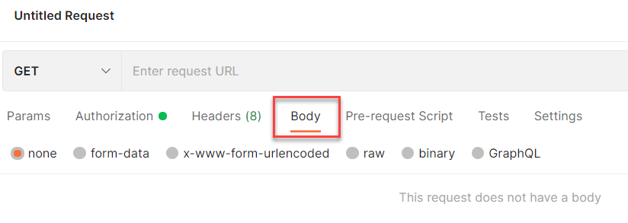
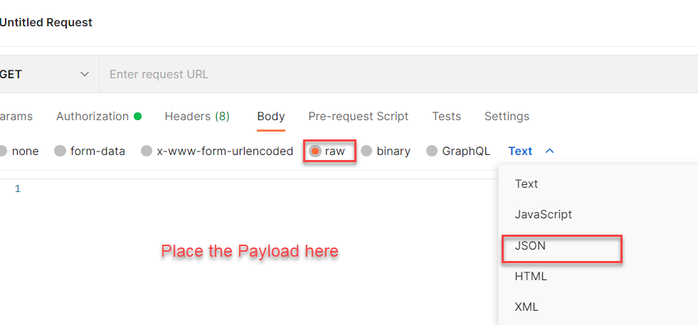
Setting the Payload for POST and PUT request
Step 1: Go to Body Section.
Step 2: Select the raw option form the radio button and then select the data type as JSON.

Slide 15
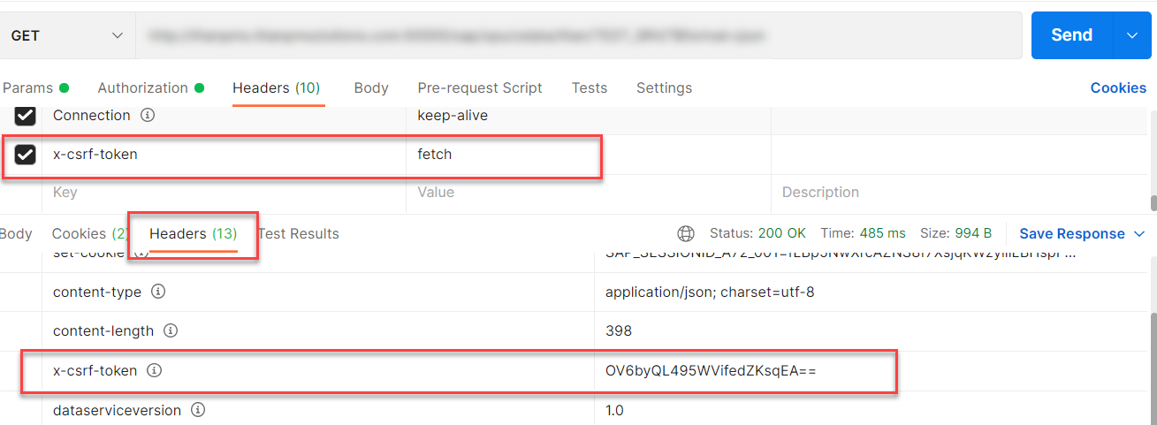
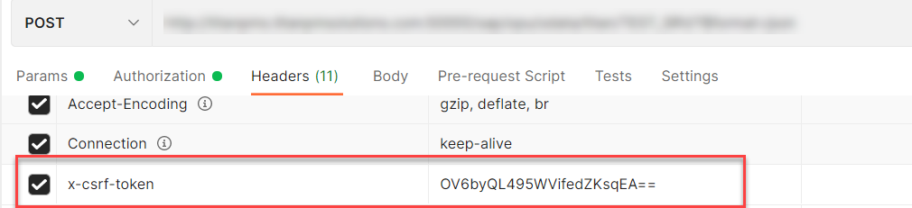
X-CSRF Token
A CSRF Token is a secret, unique and unpredictable value a server-side application generates in order to protect CSRF vulnerable resources.
The tokens are generated and submitted by the server-side application in a subsequent HTTP request made by the client.
Steps to Get the x-csrf token.
To get the x-csrf token we need to pass the value of x-csrf token as fetch with the GET call.
After executing the get call we will find the token in the Header Section of the Response.
- In POST call we need to pass this value of x-csrf token in the header section.

Slide 16
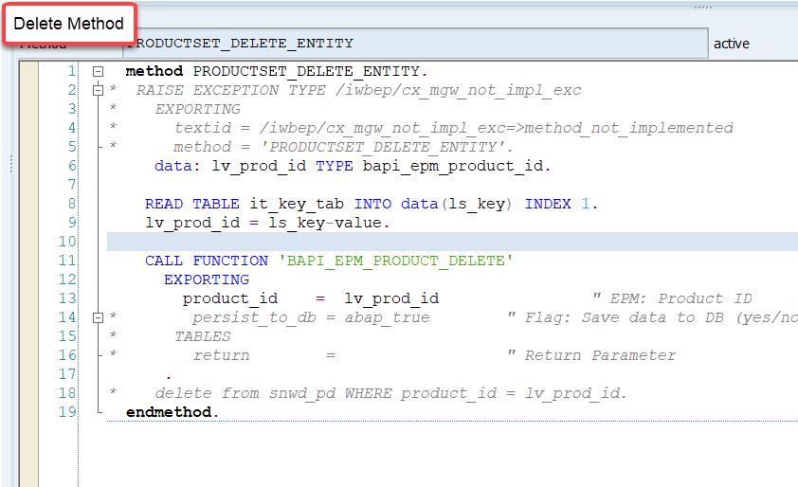
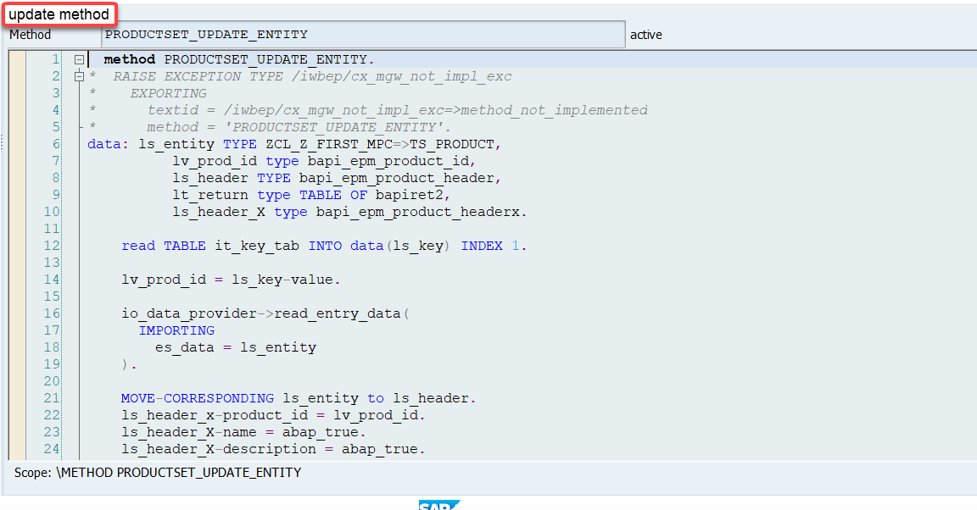
Implementing DELETE and Update (PUT) method
We can implement the delete and update method in the corresponding DPC extension classes.
Code for PRODUCTSET_DELETE_ENTITY: ProductSetDeleteEntity
Code for PRODUCTSET_UPDATE_ENTITY : ProductSetUpdateEntity

Slide 17
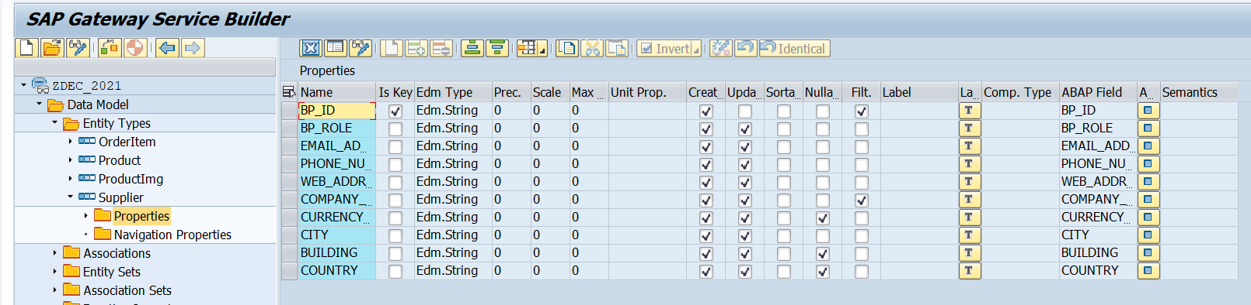
Create Supplier Table
Create a Supplier entity Set in the Entity Type Section by following the steps used to create Product entyity Set.
Supplier Set
Once the Entity sets are created, we can also implement the Get Entity for of Supplier Set in the same way as we have created for the Product Set.
Code to put in Supplier Set Get Entity:
SupplierSetGetEntity

Slide 18
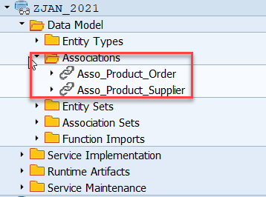
Association
Associations are relationship Between entities.
At database level we have foreign key relationship and same is reflected at odata level.
Once a association is created only then we can create navigation property.
In a typical ERP system the data is spread across multiple database tables. Example sales order header and items. We load this connected data using the foreign key relationship.
In case of OData service, each database table is transformed into an entity. Hence we also need a relation between these entities. So the foreign key is converted to a association.
Product
Supplier
1 relation 1

Slide 19
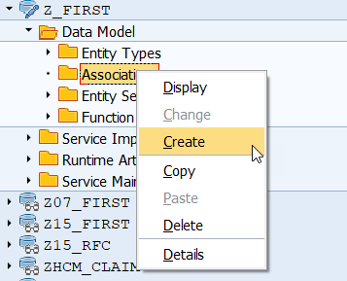
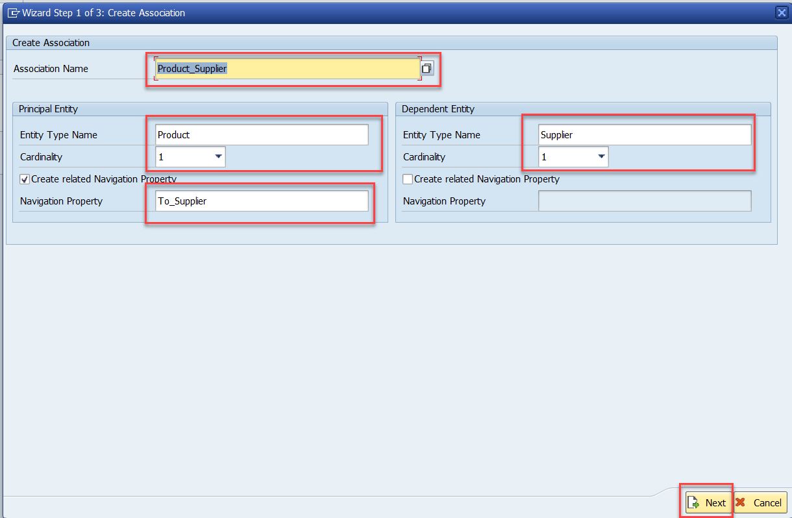
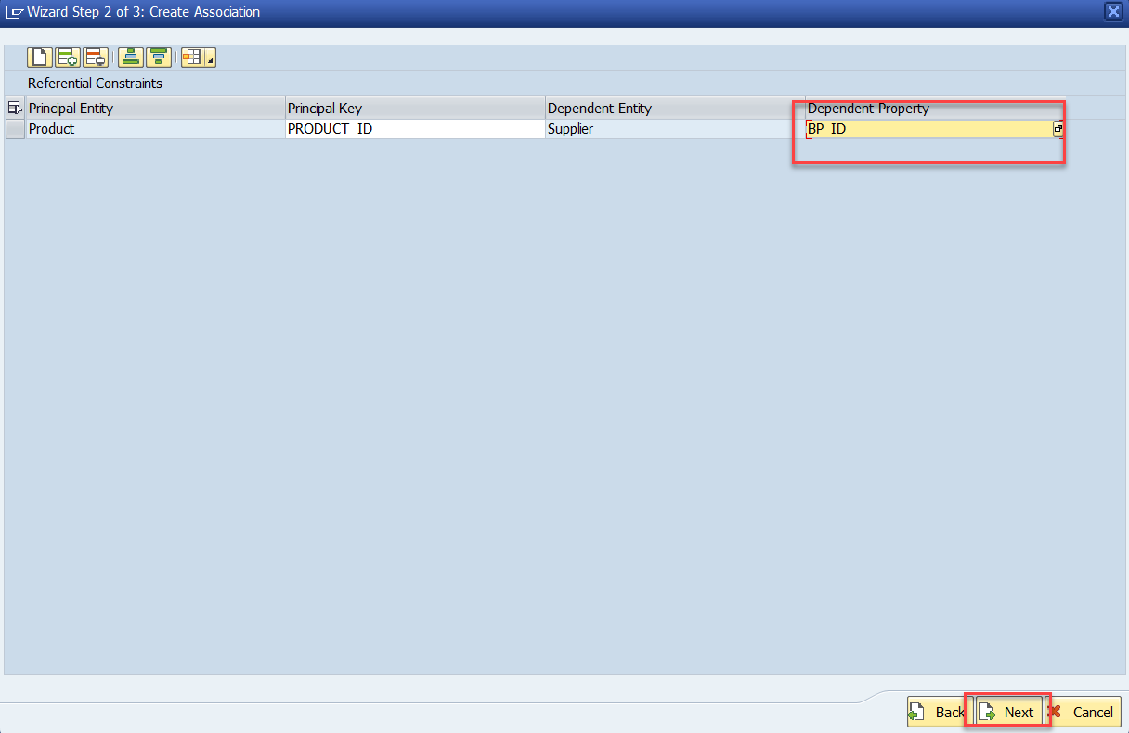
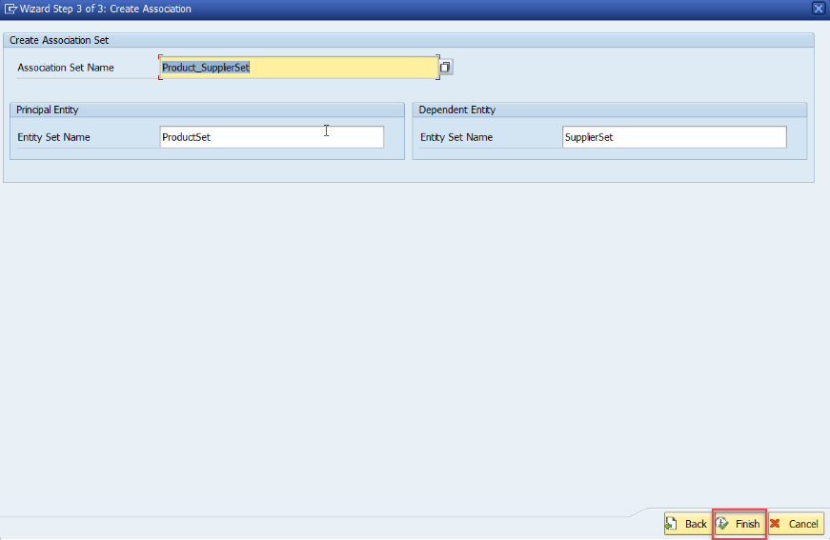
Association (1:1)
Step:1 Right Click on Association and click on create
After creating the Association for Supplier Set in Product Set, we need to change the Supplier Get entity.
Code Link:
SUPPLIER_GET_ENTITY (Association)

Slide 20
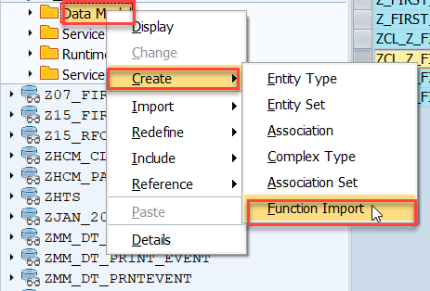
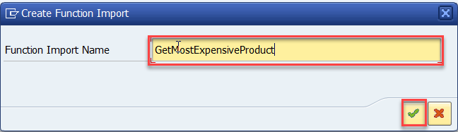
Function Import
At times, we need to implement the logic inside of OData which is not a direct CRUD operation e.g. calling a workflow, calling a BAPI which does some processing, Sending request to another server and can be invoked by the HTTP methods GET or POST .
For example: we can create the function import to GetMostExpensiveProduct in our Product set by the Category.
Step1: Right click the Data Model folder and select Create and then select Function Import. Create Function Import dialog opens

Slide 21
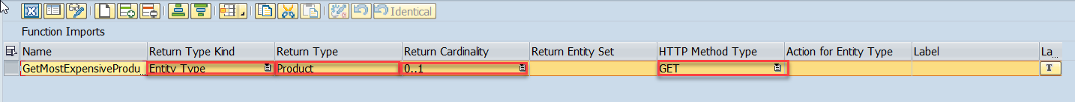
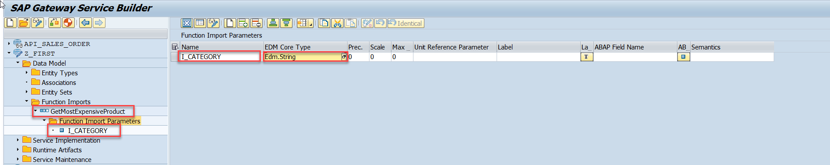
Function Import
Step2: Enter return type kind, return type, return cardinality & HTTP method Type
Step3: Giving function import parameters (I_CATEGORY)

Slide 22
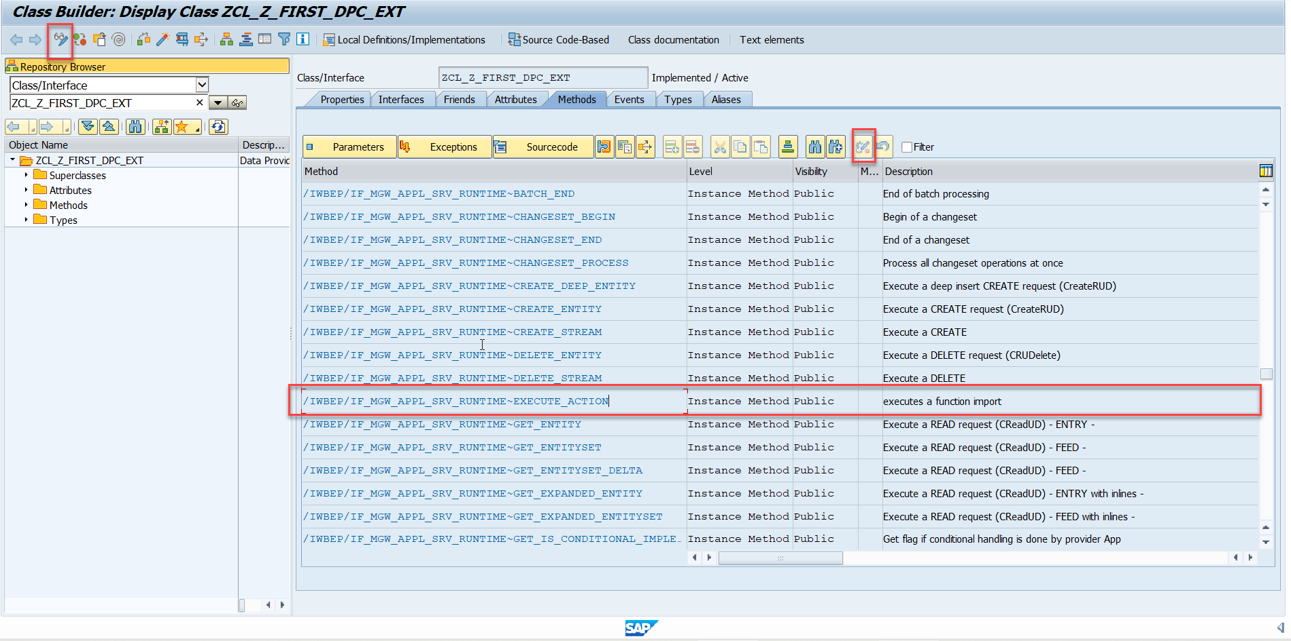
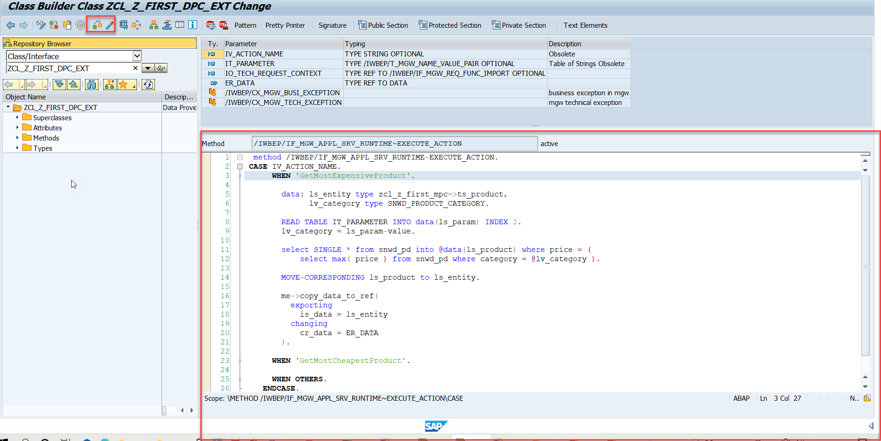
Function Import
Step4: Go to DPC Extension and search for the method--/IWBEP/IF_MGW_APPL_SRV_RUNTIME~EXECUTE_ACTION and redefine the class method
Function Import Code: funciton_import

Slide 23

Basics of Connectivity and Role of SCC
Internet
Intranet
SAP BW
SAP ECC
SAP S/4 Hana
SAP BTP (PublicCloud)
SAP Cloud Connector
SAP On-premise System
SAP Business Application Studio
SCC
Destination
S/4 Hana Cloud
Field Glass
Sales Force

Slide 24
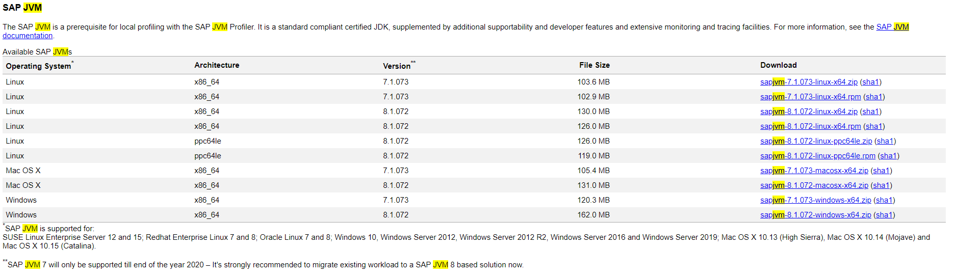
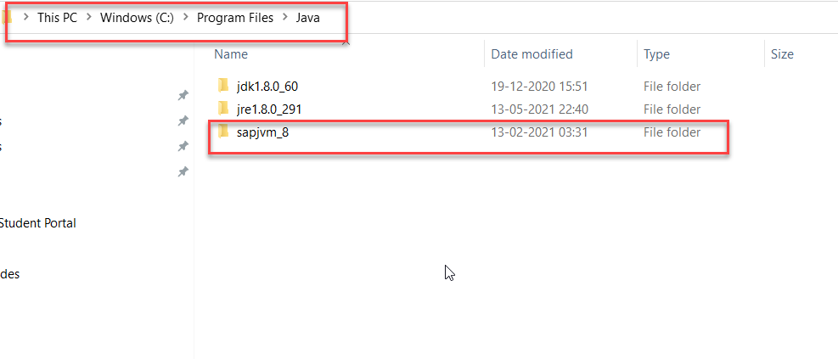
Cloud Connector
Step 1: Download SAP JVM and Extract it in the C:\Program Files\Java

Slide 25
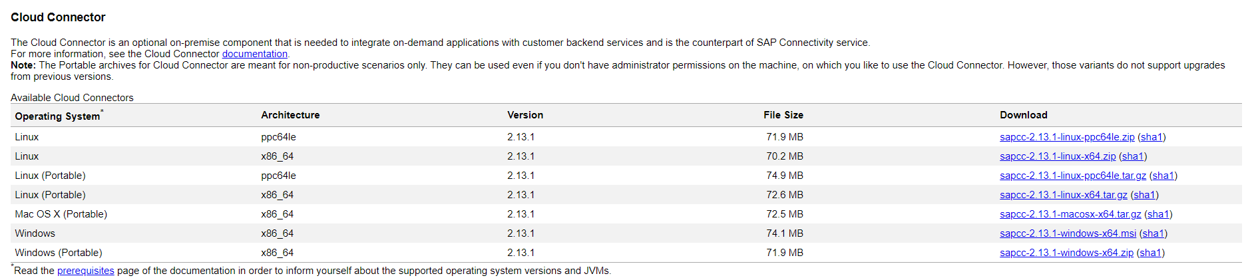
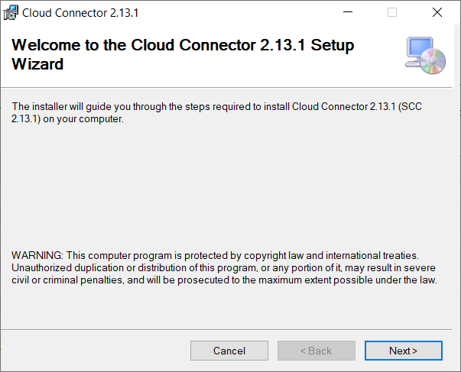
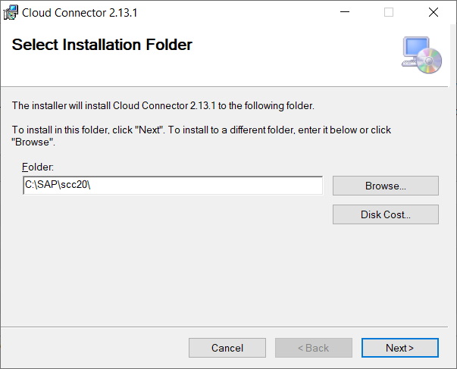
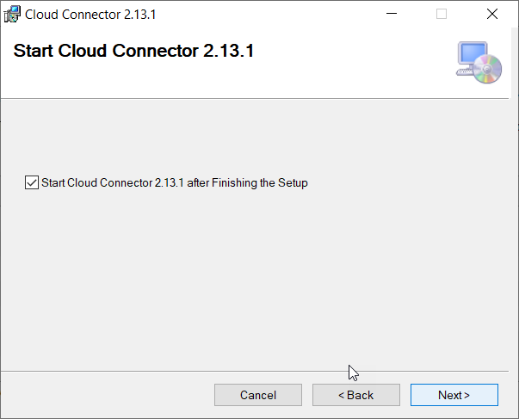
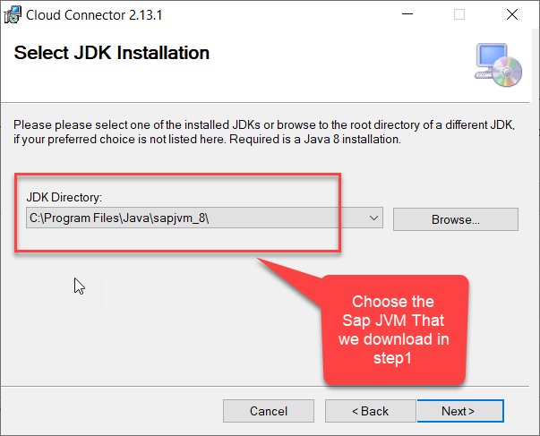
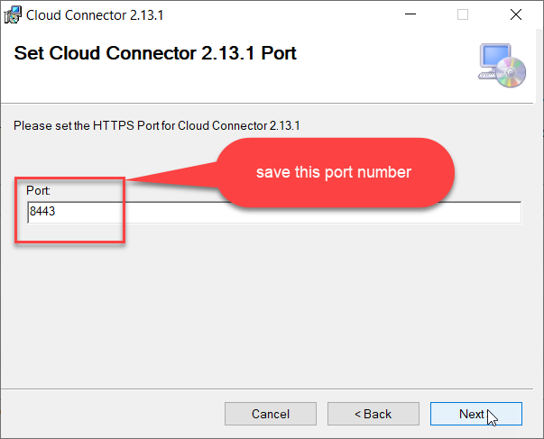
Cloud connector continue…
Step 2: Download and install the sap Cloud connector

Slide 26
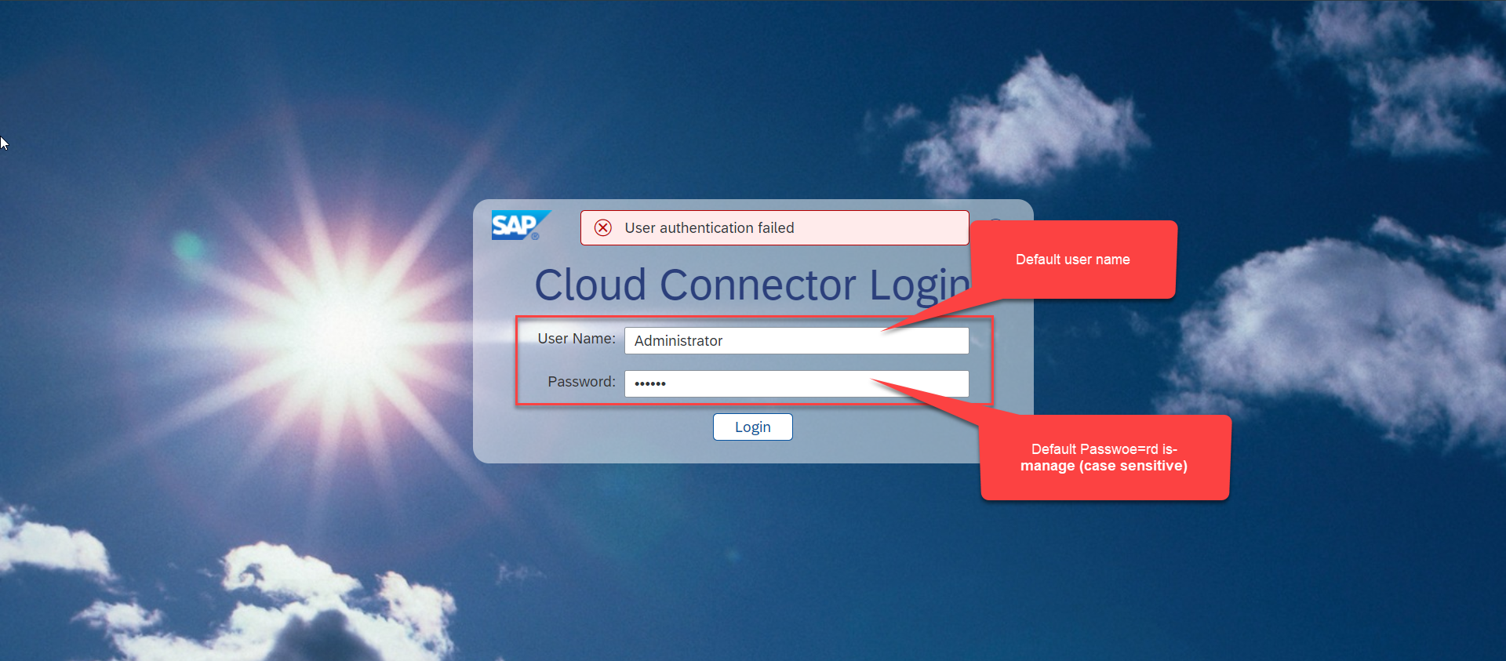
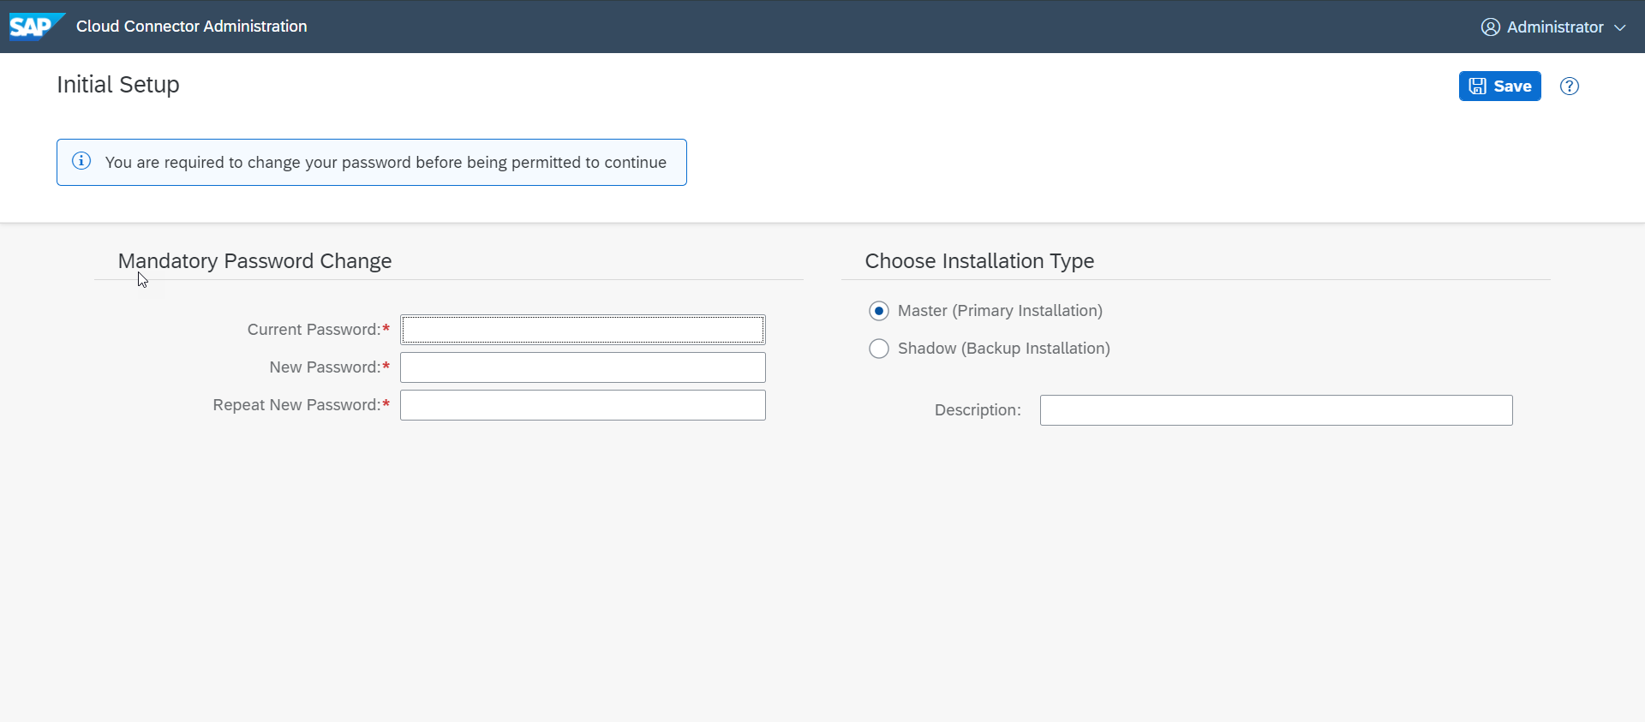
Cloud connector continue…
Step 3: Now your system is ready go to browser and open https://localhost:8443 (port may changes)
The default credentials are Administrator / manage

Slide 27
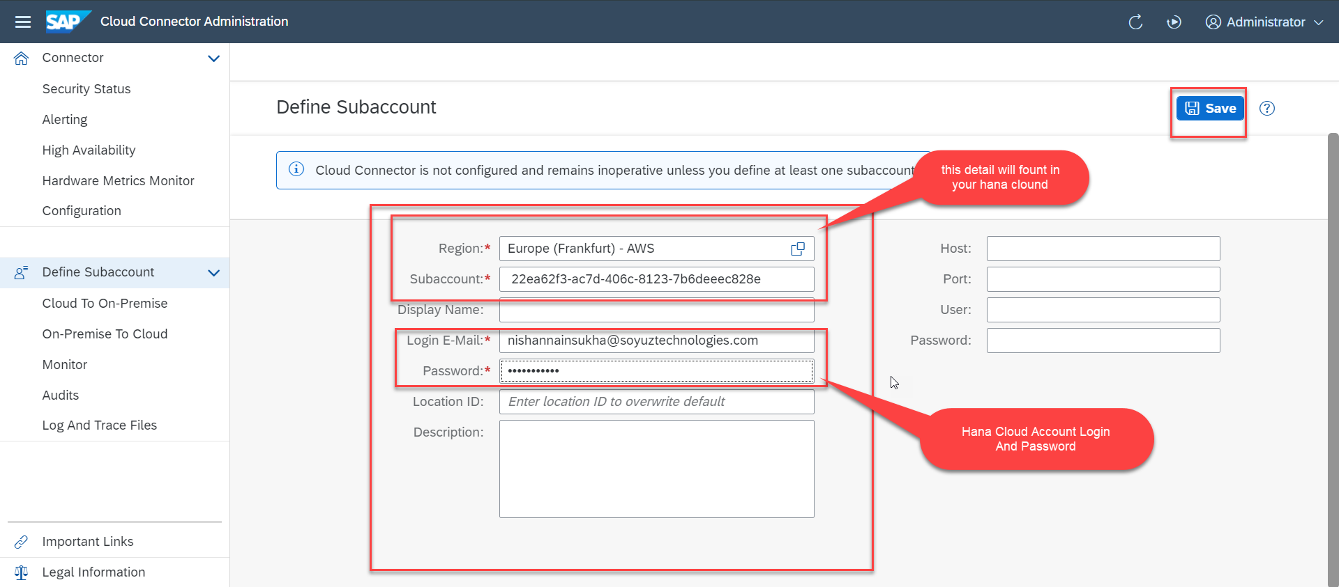
Cloud connector continue…
Step 4: Now we create a connection with our Cloud Account

Slide 28

Cloud connector continue…
Step 5: Check the connection on Hana Cloud Account

Slide 29








Cloud connector continue…
Step 6: Connect on-premise system to cloud using SCC

Slide 30

Cloud connector completed
We have Done with Connect , now we are now successfully connected to cloud using SCC.

Slide 31

Creating the Destination in BTP
Now once the cloud connector setup is done. We need to create a destination in the Business Technology Platform (BTP) to assess our SAP system in the BAS.
There are two ways to create a destination in BTP:
Create a destination directly in BTP (Not Recommended)
Creating the destination inside the BAS (Recommended)
To create a destination directly in BTP
Go to the Connectivity > Destinations and here click on New Destination
Then a new Destination Configuration will open.
Enter all the details of the system and press save.
After that check the connection with destination.
This way of creating destination is not recommended because in this method, to assess the odata service in the fiori application some additional properties are required. Adding that properties is a little tricky and can lead to error.
That’s why we will not use this method.

Slide 32





Creating Destination Inside BAS
To create the destination directly using BAS follow the step:
Start your BAS tool and in that go to the service center in the left side bar.
Then under the SAP SYSTEM section choose your subaccount and click on plus button +
Fill the details as shown and press Add. You can create a new Project for the template to test this destination.

Slide 33



Connecting system to the VSCode
Now if we want to connect our system to the vscode we don’t need the Cloud Connector, because the VS code is already running in our local system and in our local system we can use the VPN to access our SAP System.
So to connect vs code to the system:
Open application generator using the command palette.
Create any type of project (let’s select the master detail).
In the Data Sources as Connect to a System
In system select New System and system type as ABAP on Premise
And then Enter the system detail.
Then complete the project setup.
After that you can see the created system in the Fiori Tools option in the left side bar, under the SAP SYSTEM.

Slide 34

End of Day 16

Slide 35

Questions

Slide 36

Sakshi Gupta

Slide 37


We’re committed to empower you to be
Most Desirable Resource
through powerful training solutions.
We build the workforce of the future.
250+
Corporate Clients
30,000+
Learners Trained
25000+
Learners Placed
FREE WEBINARS
Sign up for free webinars with industry experts every fortnight!
Enroll Now!
Contact us today!
https://anubhavtrainings.com/

Slide 38




More from AnubhavTrainings.com

Slide 39
Title
Content

